Slide 1
Guidelines for Pre-Final year students
Training & Placement cell
KIT, Tiptur

Slide 2
HEAR FROM YOU…!
How many of you are clear about your STRENGTH?
What about your WEAKNESS?
How many of you are serious about JOB, HIGHER STUDIES, ENTREPRENEURS ?
How many of you are sure to clear the PLACEMENT DRIVES ?
What are your expectations from the session?
Asking questions is important (pre-placement)

Slide 3
WATCH THE BODY LANGUAGE
First impression is important
Allow time to relax
Dress code
Entrance, Introduction & Handshake
Smile and make EYE contact
Be aware of own movements (Eye)
Not attending the Placement drive
. On campus (less competition)
. Off campus (more competition)
. After degree (huge competition)

Slide 4
SWOT Analysis
TCS
TCS Ninja (3.5 lpa)
TCS Digital (7 LPA)
Any branch with more than 6.75 or 60% aggregate
Apply for drive
Last important step
After any edit/corrections
Online tests in ION centers
5 to 6 in Bangalore
Other places also
Tentative Test pattern (4 modules)
English (10 Q, 10 min)
Quantitative aptitude (20 Q, 40 min)
Programming logic (10Q, 20 min)
Coding (1Q, 20 min)
Shd score in all 4 modules
No cutoff will be disclosed
Technical/ HR
At TCS office, Bangalore
Updated Resume
Conversion is around 80%

Slide 5
Placement drives - 2020
Infosys (3 opportunities)
INFYTQ
No % criteria
2 opportunities
Certification
HackWithInfy
VTU drive
September/October 2019
Percentage criteria
Aptitude/ Verbal/ Paragraph etc
INFYTQ Certification
No % criteria
Python
Have requested Bhavana madam for classes on 9th & 10th
Register using app
Practice 4 modules in the app (120+ hours)
Date of online test & place will be announced later
Don’t select places which are very far and later don’t change places
65 shd be scored out of 100 (20+20+60)

Slide 6
INFOSYS
Certification
HackWithInfy

Slide 7
A RESUME
Is the first meeting between you and the interviewer
Tells a GREAT deal about YOU.
So remember that “ First impressions are lasting ones…”
Convince the interviewer that you are worth an interview
Keep as brief as possible without sacrificing essential qualifications.
You achieve the greatest possible positive effect when you share the right information in an easy-to-read format that looks professional.
Email – keep it professional
NO errors (c, Ms, spelling, alignment, copying)
Do not Fold resume
Never use – “I” , “ME”, “MY”, “OUR”
Include specialty (NPTEL, extra curricular, sports, hakathon, conferences, internship details etc)

Slide 8
Key to Success
Reasons for less success
Keeping notifications off
Not reading & understanding properly
Mock test
Resumes
Attire
Bulk recruiters
Keep target companies (Prepare as if that’s the end)
Learn basic C programming (Technical & Coding skill)
Importance of Internships (Some ECE students done I guess)
Research about organization
Websites, reports, articles, company literature, etc
Contacts with knowledge of organization or sector
Relevant articles in the press
Feedback from companies

Slide 9
WHAT CREATES A BAD IMPRESSION (Failure)
Poor personal appearance
Negative attitude – evasive ( tending to avoid COMMITMENT), Excuses
Lack of confidence, interest and enthusiasm
Lack of preparation
Poor knowledge of role
Lack of career plan
Lack Of Clarity (Is Not Only Exhausting For An Interviewer But It’s Also Frustrating And Irritating)
VAGUE And DISHONEST ANSWERS Are Common Practice In An Interview Situation, And Employers Know It …

Slide 10
Google form
If placements @ KIT
If pool campus
If VTU drives
JV Global training
5th, 6th & 7th training
8th specific training for TCS eligible students
Python
Training from Bhavana madam
After registrations only (Interested students)

Slide 11
INTERNSHIP
ABC
They have 3 modules
Internship + training + placements
If interested can call for presentation on 9th July
DLITHE
MECH students
3D printing in department
TechFortune

Slide 12
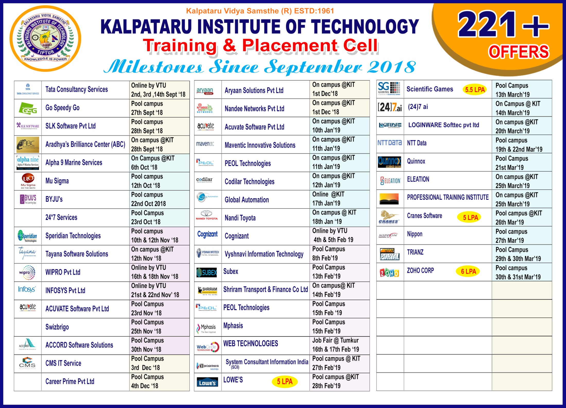

Slide 13
This is not an “END” but a “START” to the infinite journey…!!

